Slide 1

‘I believe in the Holy Spirit’
John 14:15-27

Slide 2

‘I believe in the Holy Spirit’

Slide 3
Paraklete:
- Counsellor
- Advocate
- Comforter
‘I believe in the Holy Spirit’

Slide 4
‘When you believed [in Christ], you were marked in him with a seal, the promised Holy Spirit.’
Eph. 1:13
‘I believe in the Holy Spirit’

Slide 5
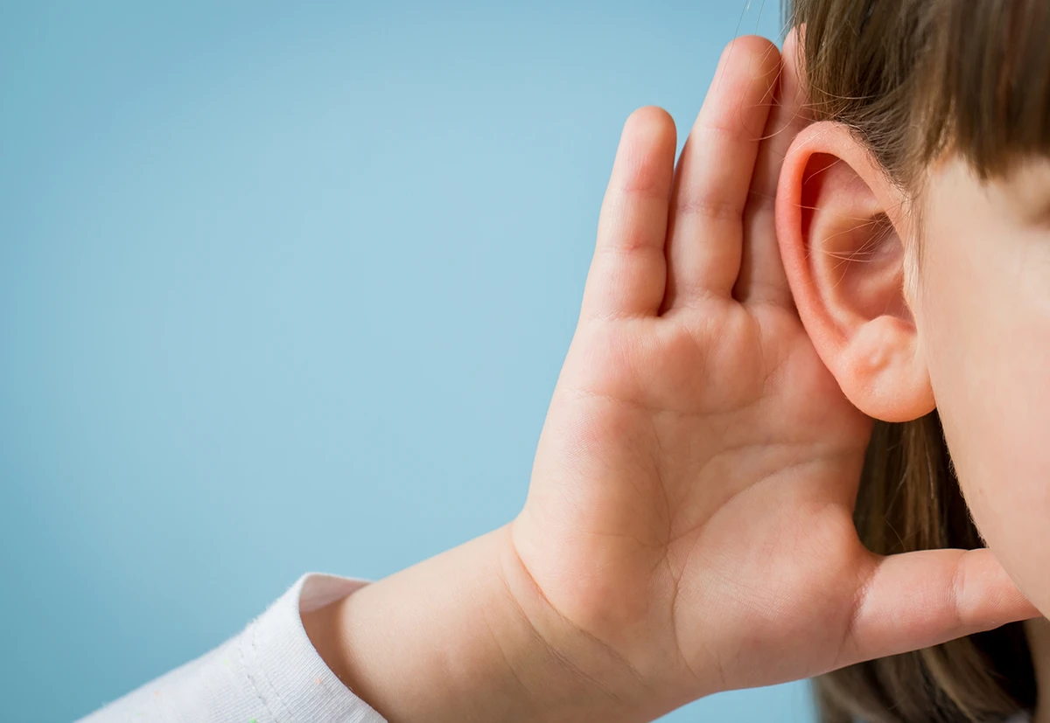
The Holy Spirit helps us to hear God speak

Slide 6
The Holy Spirit helps us to hear God speak
“‘In the last days, God says,
I will pour out my Spirit on all people.
Your sons and daughters will prophesy,
your young men will see visions,
your old men will dream dreams.
Acts 2:17

Slide 7

The Holy Spirit helps us to speak to God

Slide 8
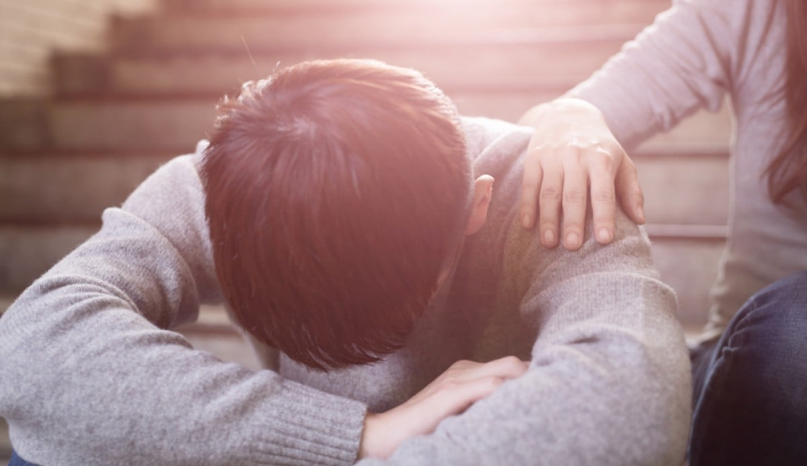
The Holy Spirit strengthens us

Slide 9
The Holy Spirit strengthens us
‘I pray that out of his glorious riches he may strengthen you with power through his Spirit in your inner being’
Eph. 3:16

Slide 10

The Holy Spirit brings us peace

Slide 11
The Holy Spirit brings us peace
‘the fruit of the Spirit is love, joy, peace, patience, kindness, goodness, faithfulness, gentleness and self-control’
Gal 5:22-23

Slide 12
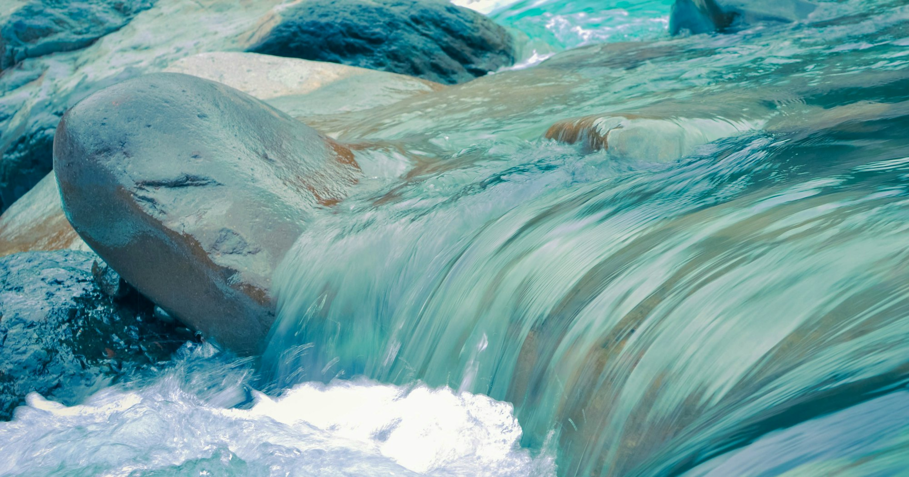
Rivers of living water

Slide 13
‘Which of you fathers, if your son asks for a fish, will give him a snake instead? Or if he asks for an egg, will give him a scorpion? If you then, though you are evil, know how to give good gifts to your children, how much more will your Father in heaven give the Holy Spirit to those who ask him!’
Luke 11:11
Rivers of living water

